Slide 1
Large Language Models
Jian Tang
HEC Montreal
Mila-Quebec AI Institute
Email: jian.tang@hec.ca

Slide 2
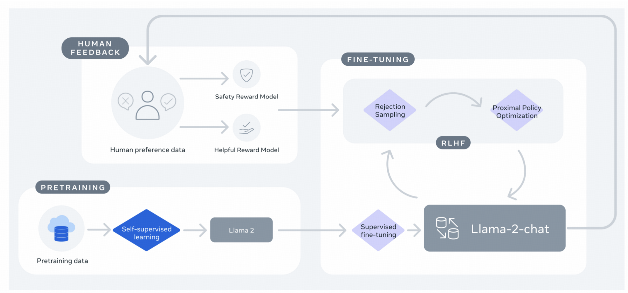
Overview of LLMs Training
Pretraining -> Supervised Fine-tuning (SFT) -> Reinforcement Learning Human Feedback (RLHF)

Slide 3
Outline
Fine-tuning
Instruction Tuning
Prompting

Slide 4
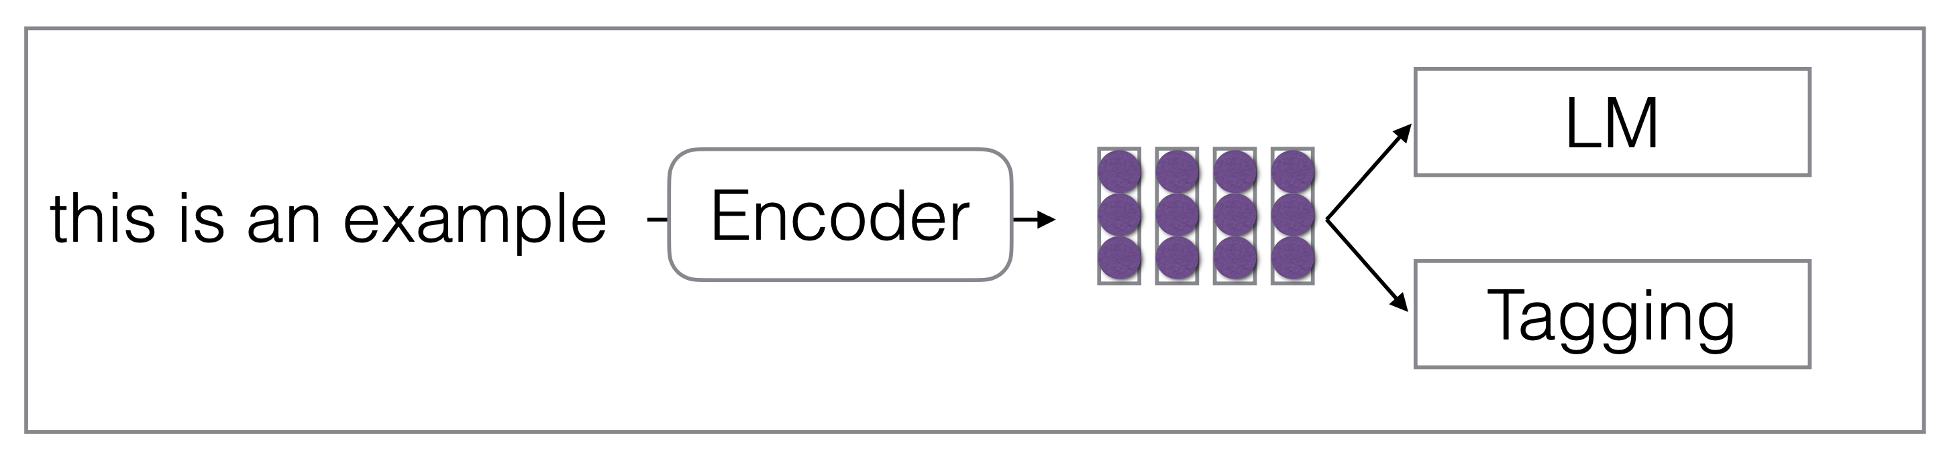
Standard Multi-task Learning
Train a neural network for multiple different tasks

Slide 5
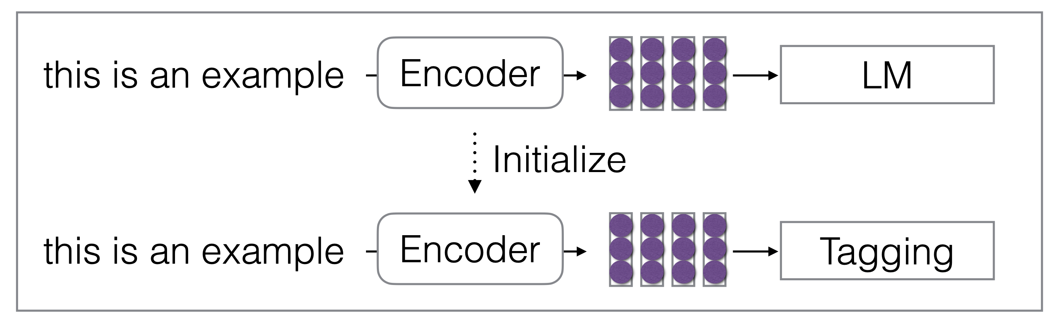
Pre-train and Fine-tune Framework
Pre-train a model on a set of tasks and then fine-tune it on new tasks
E.g. Pretrain a LLM and then fine-tune it with a classification task

Slide 6
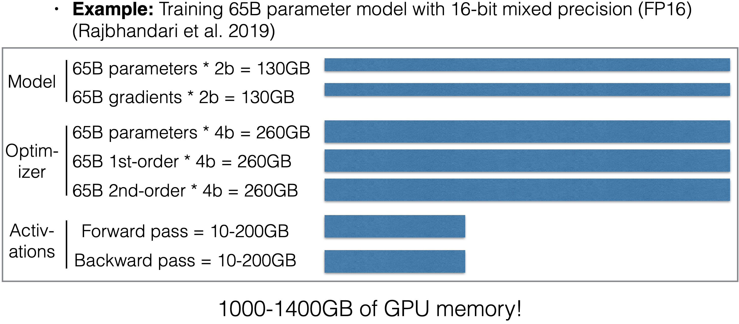
Full Fine-tuning
Fine-tuning the entire parameters of LLMs are too expensive

Slide 7
Parameter-efficient Fine-tuning
Don’t tune all of the parameters, but just some
Prompt/prefix tuning
Adapters
BitFit
LoRA

Slide 8
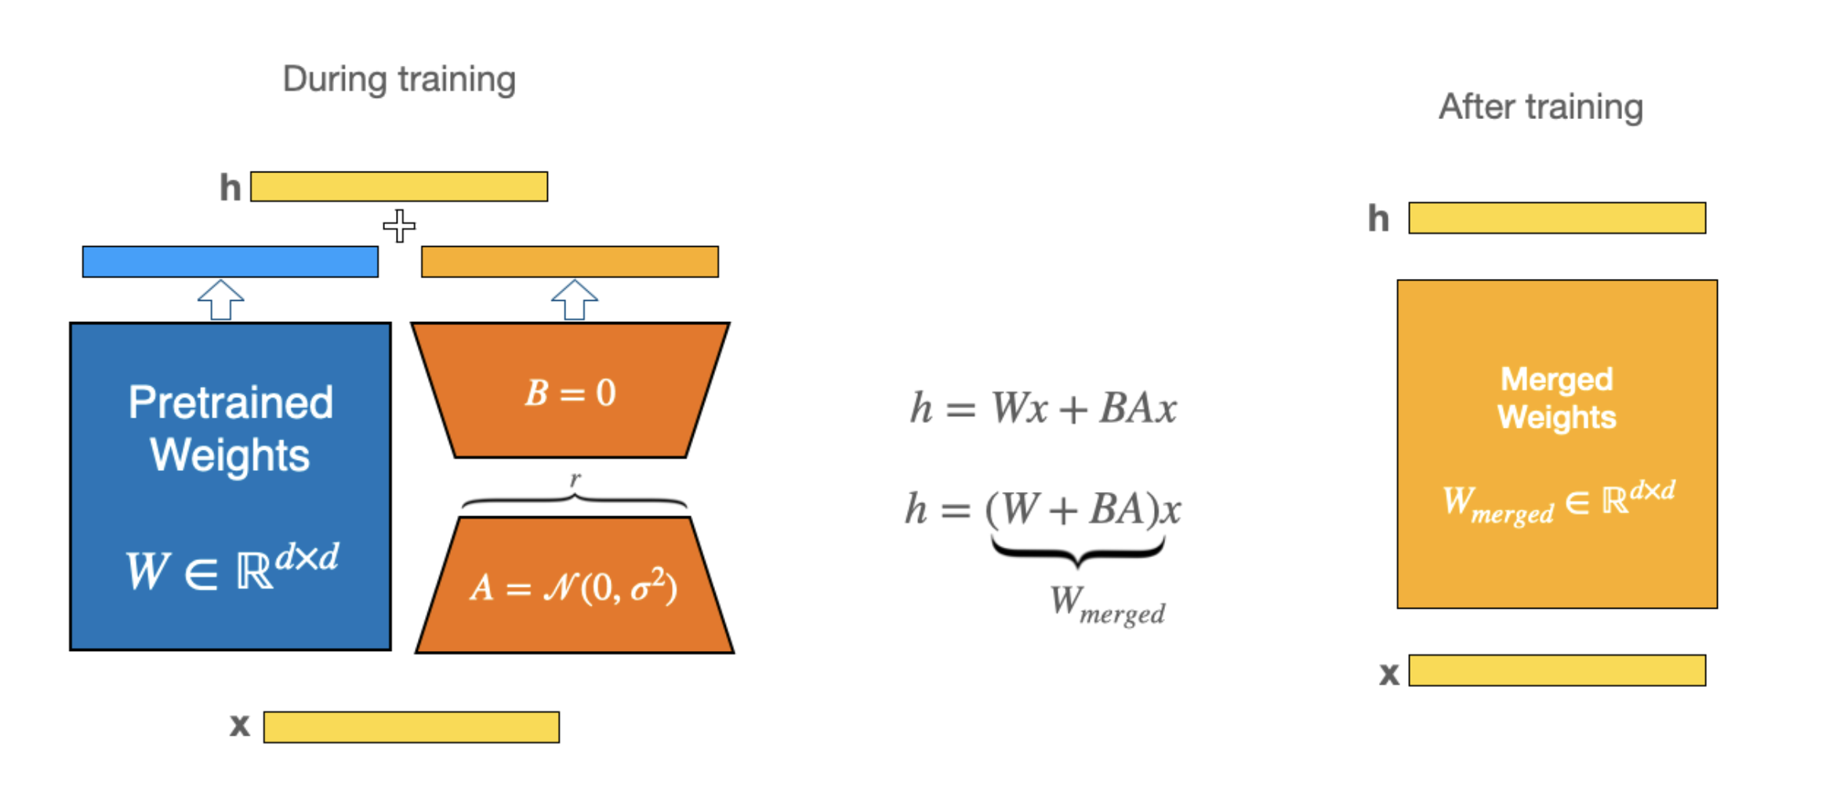
Efficient Fine-tuning: LoRa (Hu et al. 2021)

Slide 9
Fine-tuning Llama 2 in Google Colab
https://colab.research.google.com/drive/1wbPpB3fY9YRzebrZq6WkP5HxMuHMQR72?usp=sharing

Slide 10
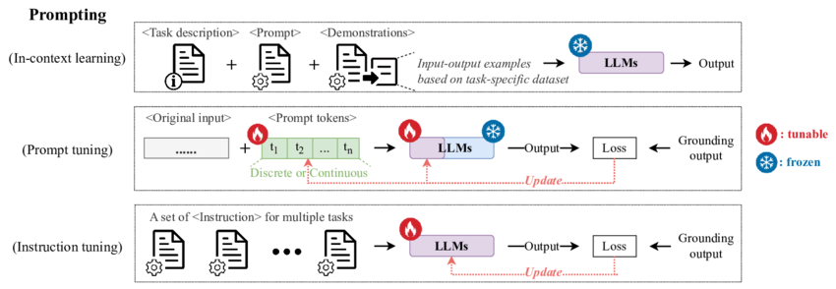
Prompting
Train on LM tasks, and then make predictions in textualized tasks

Slide 11
Thanks!

